Slide 1
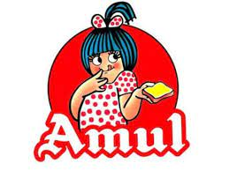
TITLE: Comprehensive -Digital-Marketing-For-Amul

Slide 2
The project presented by :
Names :
JOSEPH SAMRAJ :TEAM LEADER AND PROJECT ANALYSER AND CREATED,INFORMATED COLLECTED REGARDING THE PROJECT,LOGOS AND PICS COLLECTED REGARDING THE PROJECT,COLLECTED THE SEO AUDIT.
YENGALA PRANAY:(KEYWORD RESEARCH AND REGARDING RATIOS PICTURES,THE STRATEIES AND COMPETITORS INFORMATION COOLEECTED)
FROM :
SSGS AIDED DEGREE COLLEGE
2

Slide 3
> ​Research Brand: AMUL
MISSION:"Satisfy the taste and nutritional requirements of the customers of t world, through excellence in marketing by our team. Through co-operative networking, we are committed to offering quality products that provide best value for money."
Values
* HEALTHY CONSUMERS.
* SERVING THE SOCIETY.
* HEALTHY AND FRESH PRODUCTS.
* CORPORATE SOCIAL RESPONSIBILITY.

Slide 4
USP OF AMUL ; The main USP of the Amul brand is its low pricing. It hits the transnationals by reducing the prices on its product portfolio. The competitive advantage is its "backward integration strategy," which helps substantially in cost reduction. no middlemen:. The model of Amul is such that it benefits small producers like farmers, who together form an integrated approach to form an economically large-scale business. The model eliminates middlemen, bringing producers in direct contact with the customers. Brand Identity : Building Brand Identity: Examples of Memorable and Iconic ...Amul is a renowned Indian dairy brand known for its innovative and memorable brand identity. Here are some fun facts and figures about Amul's brand identity: The Amul girl: One of the most iconic elements of Amul's brand identity is the adorable Amul girl. Brand Tone : However, Amul's tone is consistently kind and laid-back. By inventing their own slang phrases, they promote their products and brand. And the taste of india is tagline of amul brand.

Slide 5
Smart goals :The SMART in SMART goals stands for Specific, Measurable, Achievable, Relevant, and Time-Bound.
Organizational Goal : Business and strategic objectives that define Amul Dairy's mission are known as organizational goals. Organizational goals are long-term strategic objectives that Amul Dairy hopes to accomplish. Generally speaking, this time frame is lengthy. The objectives of Amul Dairy aid in guiding both the short-term company operations and the behavior of its employees.
Achievable Goal :The goals set by Amul Dairy should be achievable. This means that Amul Dairy should have the resources and the finances necessary for being able to realize the organizational goals over the long haul. Amul Dairy should also have the strategic leadership to be able to achieve these organizational goals.

Slide 6
6
Develop goals :
strategic :Amul has a low-cost pricing strategy for products that are consumed regularly. This pricing strategy of Amul made it affordable for its target audience. Increasing the price of goods proportional to their audience's increase in income helped them retain their customer base. Brainstorming :Set objectives that will assist Amul Dairy in achieving its long-term direction. group objectives based on themes. Group the objectives and give a brief description of each group and cluster.Set long-term objectives for the business based on several clusters and groupings. Prioritization :Implement goalhree-tiered structure with the dairy cooperative societies at the village level federated under a milk union at the district level and a federation of member unions at the state level.s :
Communication :Share the objectives with all managerial levels.All necessary parties, such as distributors, stockholders, outside contractors, etc., should be informed of the goals.Customers may also be informed of goals.By outlining roles and milestones required for achievement, communication of goals will assist Amul Dairy in achieving its objectives.regular strategic analysis

Slide 7
Buyer’s/audience’s persona : Amul has a broader target audience, from a toddler to aged people. It caters to the widest range of products, like Amul milk, buttermilk, lassi, butter, cheese, milk powder, etc., for every social group and member of society by keeping their best interests in mind to meet their needs at an affordable price.
Customer-Based Target Audience :
7
customers | Amul Products
kids | Chocolates, Amul cool, Amul milk.
youth | Amul pizza, Cheese, Cheese spread
Health conscious | Amul shakti, Amul lite Butter

Slide 8
Industry-based target audience
8
Amul has segmented Milk for various industries such as ice-cream manufacturers, restaurants, coffee shops, and many similar industries.
Further, it has segmented Butter, Ghee, and Cheese for bakeries, pizza, snack retailers, confectionaries, and many more.
The target audience study tells us that Amul has a strong presence in both business-to-business (B2B) and Business-to-Customers (B2C).
This is how Amul’s target audience is served, given that it has a decent concentration in both B2B and B2C segments. Let us understand the marketing strategies and campaigns implemented by them to market themselves in the next section of this case study.

Slide 9




swot analysis of amul
9
strenth
weaknesses
opportunity
threats
*Strong dependency on weak infrastructure & completely dependent on villages for its raw materials
Risks of highly complex supply chain system
* Short self life of its Product
*Alliance with third parties who do not belong to the organized sector
* Largest food brand in India & Asia
*High Quality, Low Price
* Introduced TQM
* World's Largest Pouched Milk Brand
*Annual turnover of 4300 Crore(2006-07)
§ Highly Diverse Product Mix
• Robust Distribution Network
* Penetrate international markets
*Diversify product portfolio to enter new product categories and expand existing categories
like processed
foods, chocolates ete.
Use internet to sell its products
*Competitors - Hindustan Lever, Nestle, Britannia and local players
*Stiff competition from MNCs in butter
*Growing price of milk and milk products

Slide 10
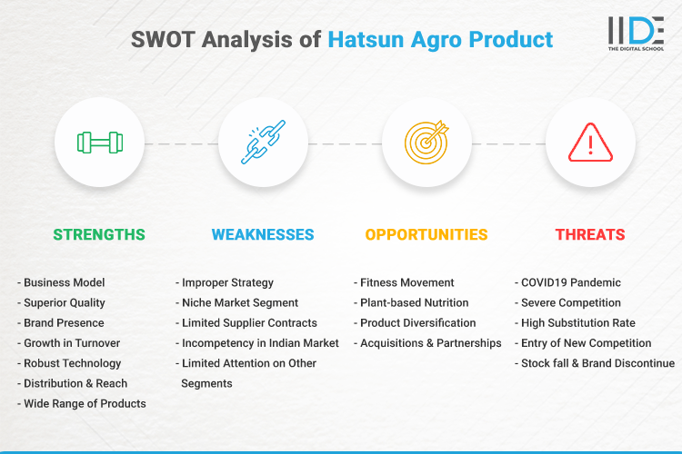
Competitor Analysis
10
COMPETITOR 1 : HATSUN

Slide 11
11
COMPeTITOR 2 : kwality wall
STRENGHT: • Innovative (using latest technology for the manufacturing of the ice or tamie comnuterized• Walls use unique innovative packing due to which people go for their product. WEAKNESS:Perception about the company is that it is specially made for high class consumers. This perception is affecting company image although Walls is making ice cream for every class at OPPORTUNITIES:Can introduce diet ice cream in market because now days people are health conscious.• Range of the product can be increased especially for the kids because kids are the major buyers of ice creams products.
THREATS:Private ice cream parlors are the major threat because of them the companies revenu get affected.

Slide 12
COMPETITOR 3 : cadbury
Strengths:
*Well established brand*Huge market share 70%*Rich product mix*Aggressive marketing*Price according to Indian market
Weaknesses:
*Dental problems with chocolates consumptionUttle penetration in nural secOthercompettor have betterinternational a netunts
Opportunities:
*Intrease share throughtargeted acquisition*Increases acceptance of Globalization in sector.annovateum ceotutedmarket
Threats:
*Cut throat comp : Nestie Amul-Entry of international brands•Obiession with calonien*Negative publicity and controversies
12

Slide 13
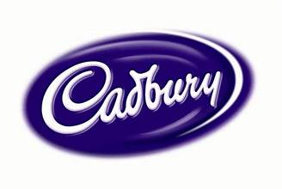

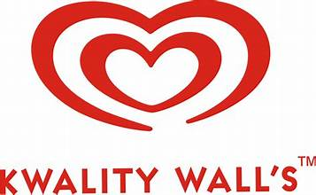
Competitors brand logos :
13

Slide 14
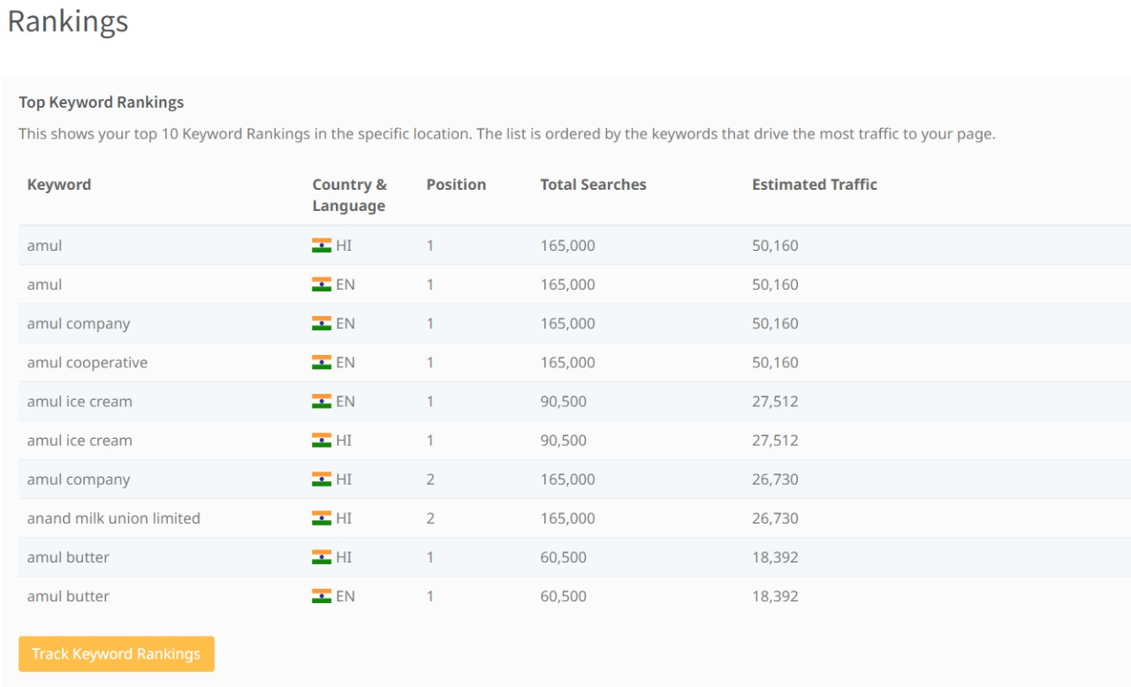
SEO AUDIT OF AMUL BRAND :
14

Slide 15
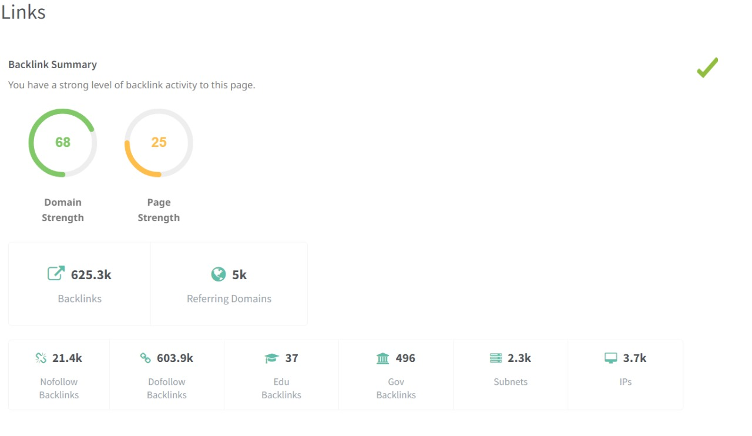
15

Slide 16
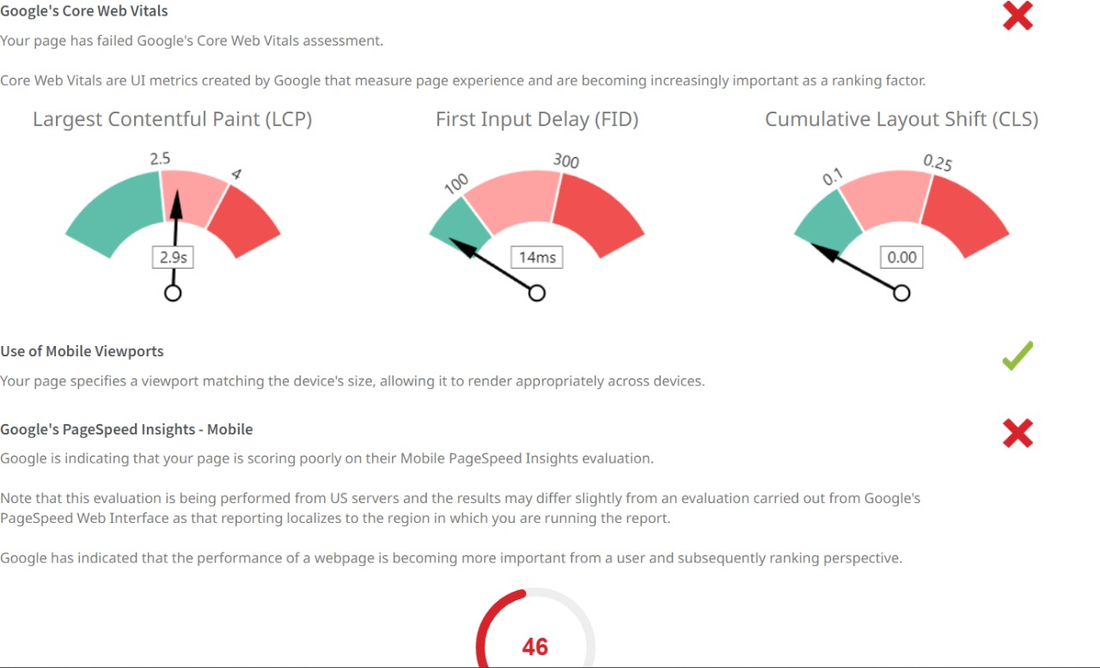
16

Slide 17
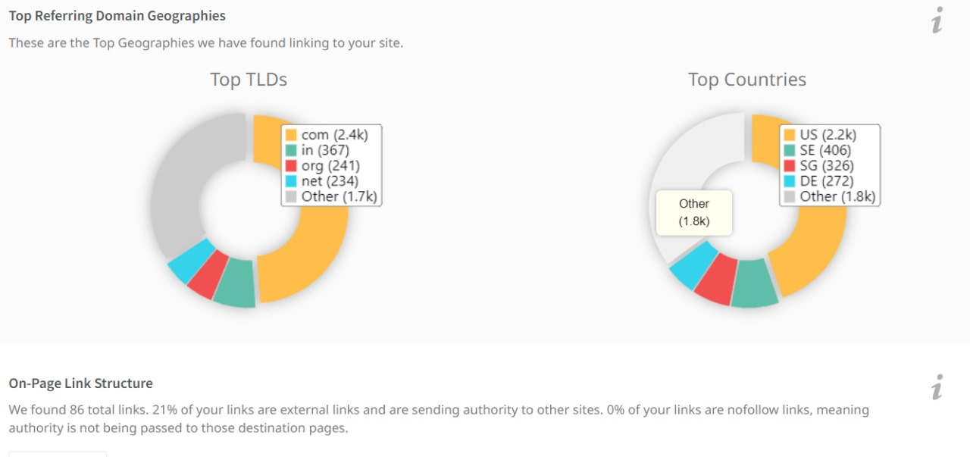
17

Slide 18
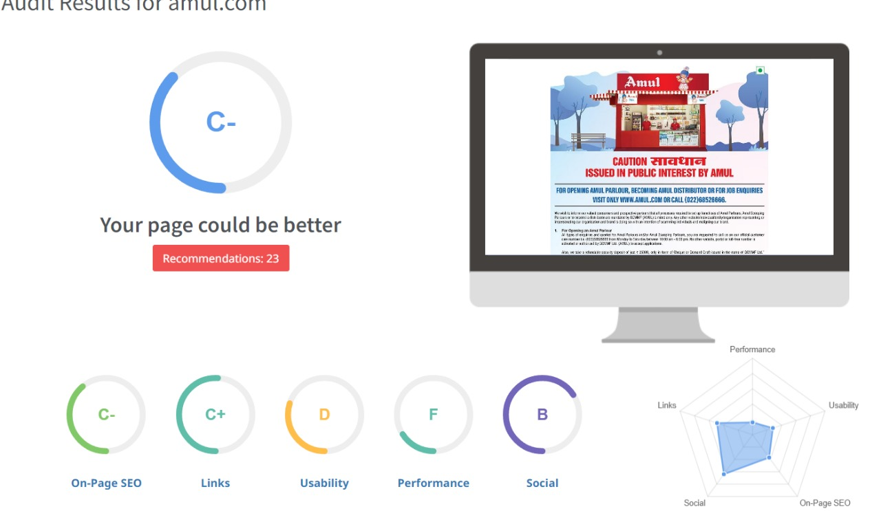

Slide 19
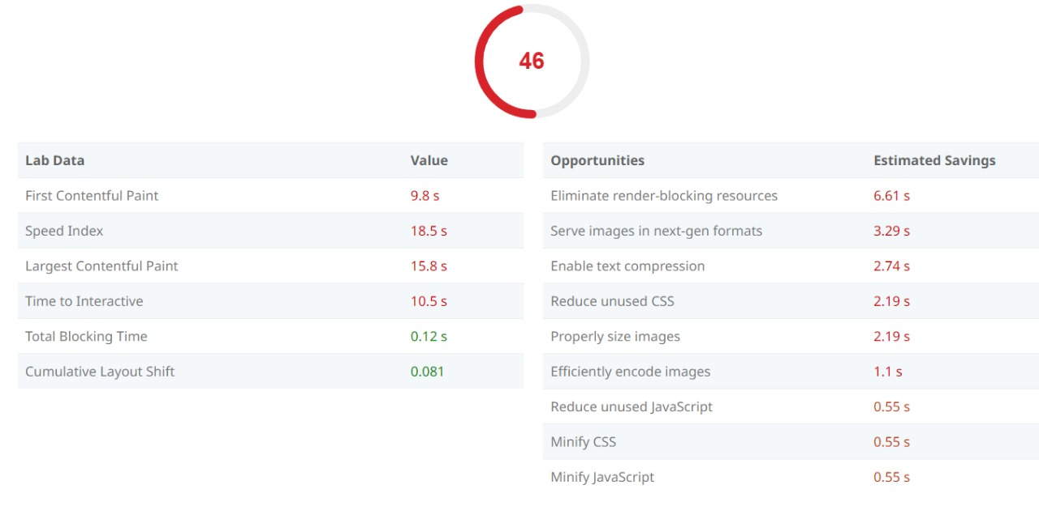

Slide 20
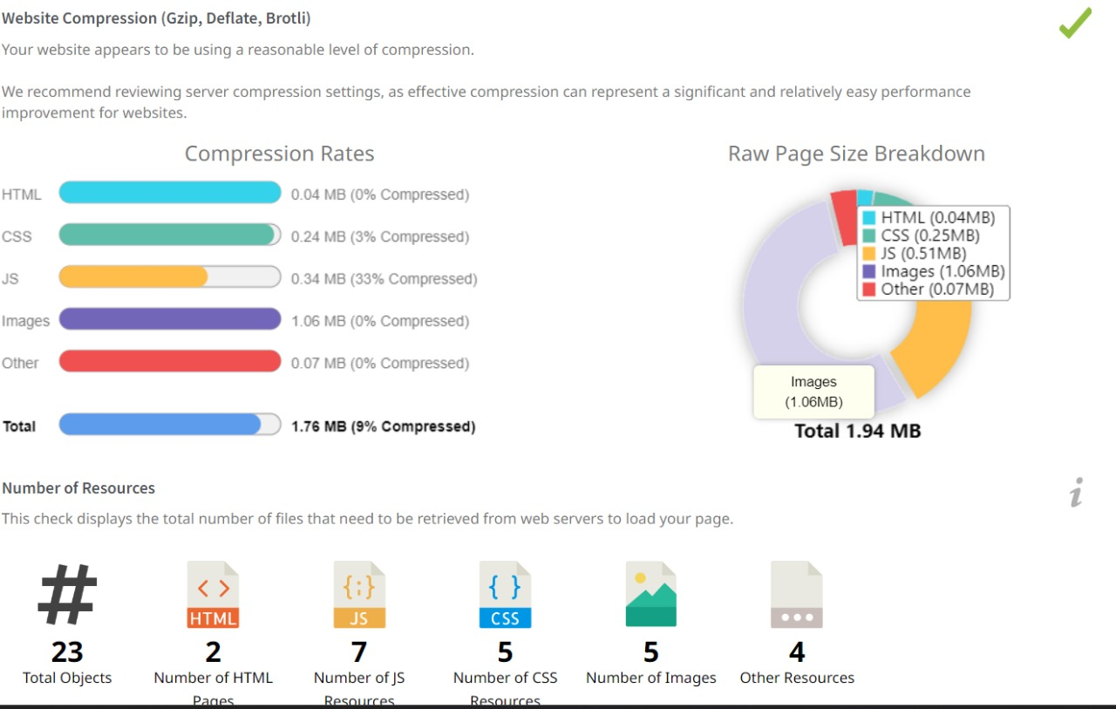

Slide 21
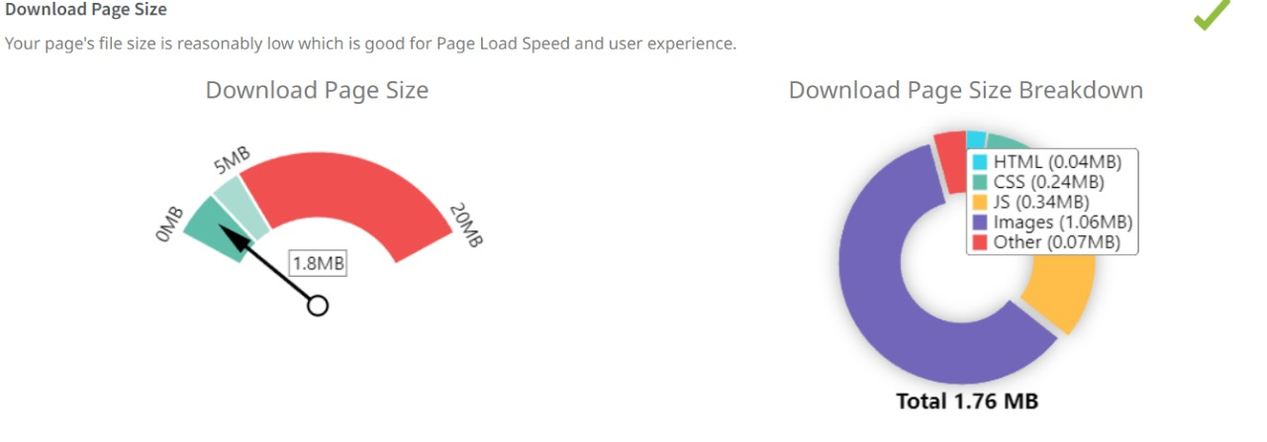

Slide 22
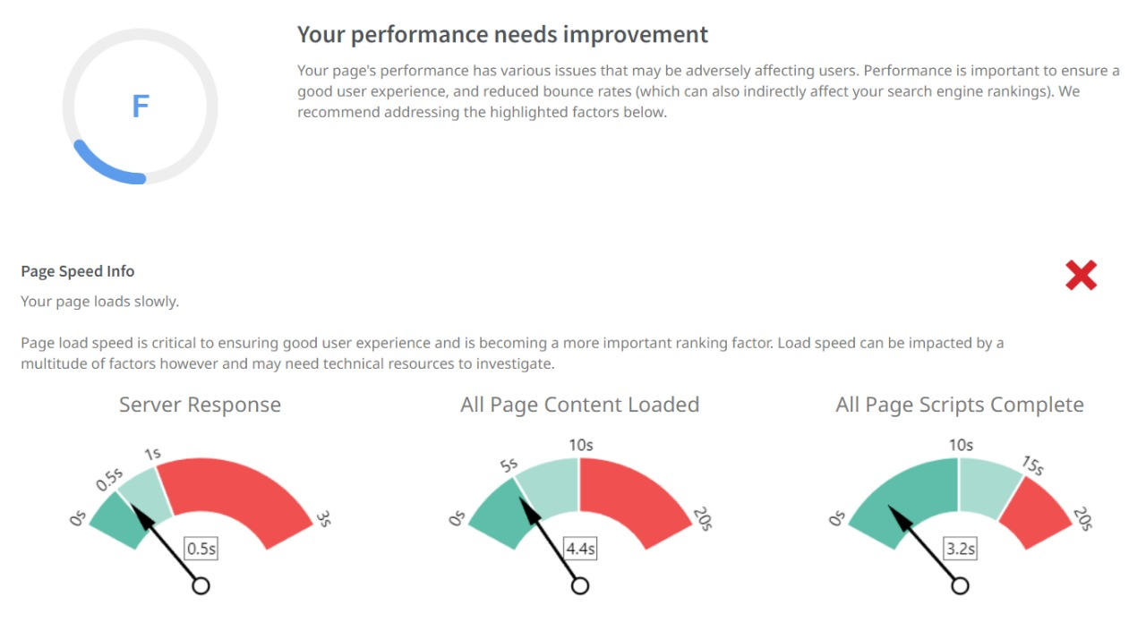
22

Slide 23
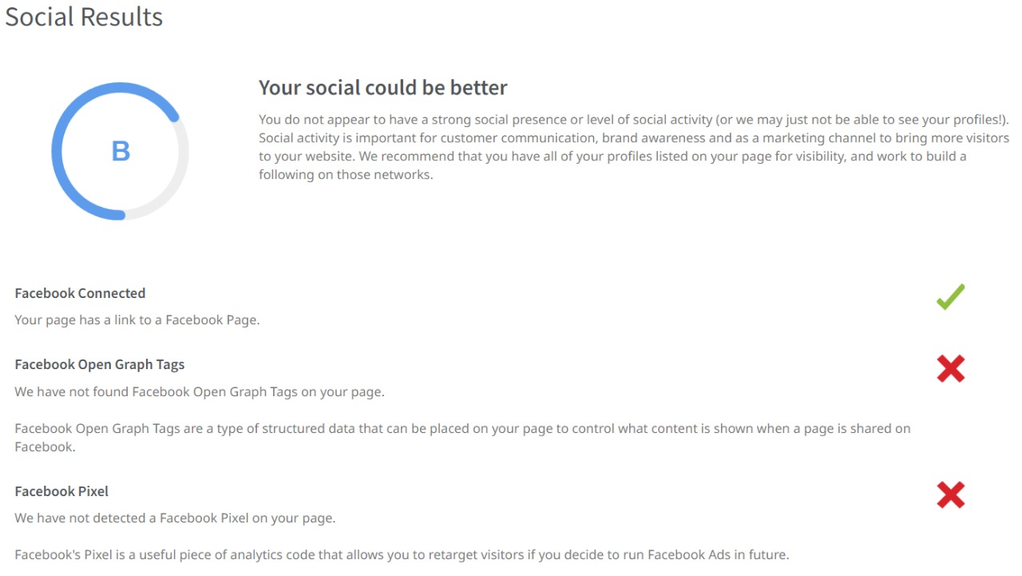
23

Slide 24
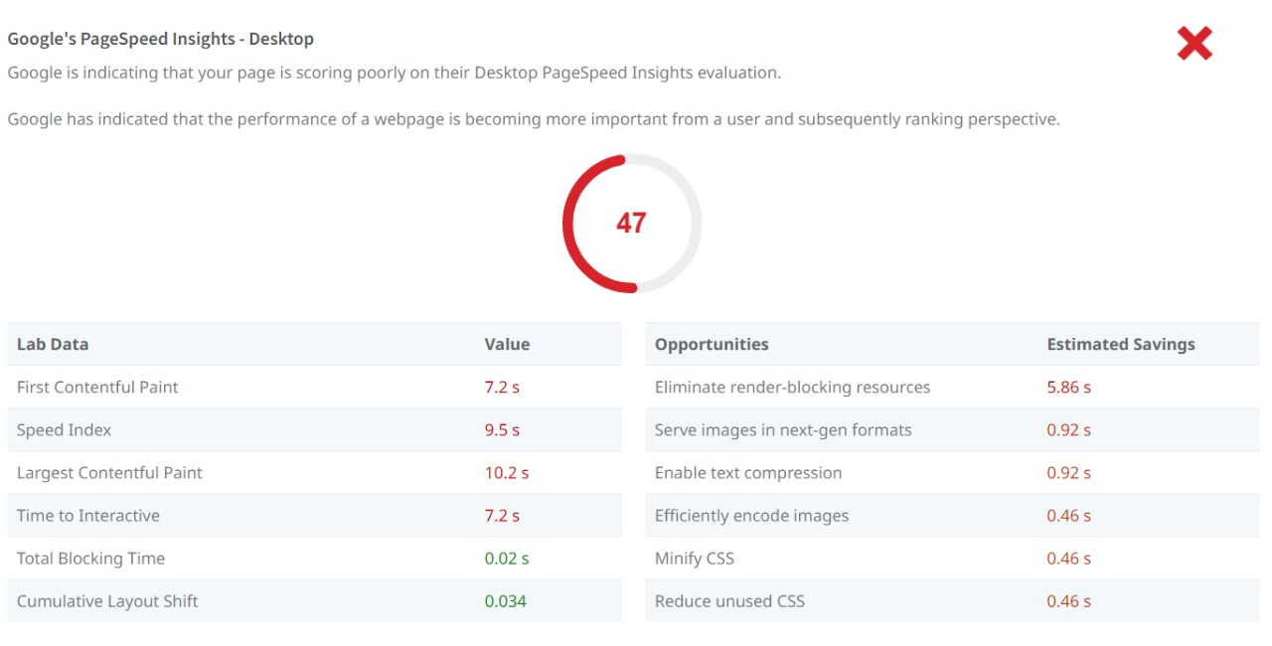
24

Slide 25
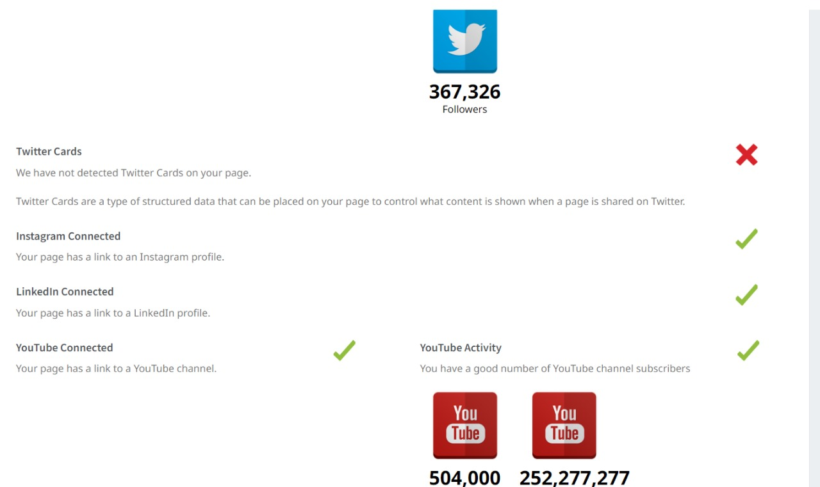
25

Slide 26
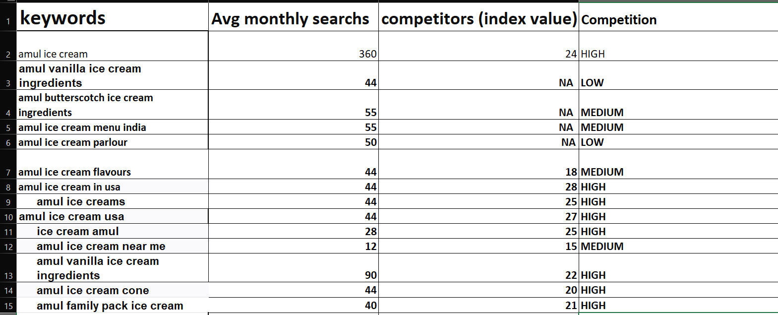
KEYWORD RESEARCH
26

Slide 27
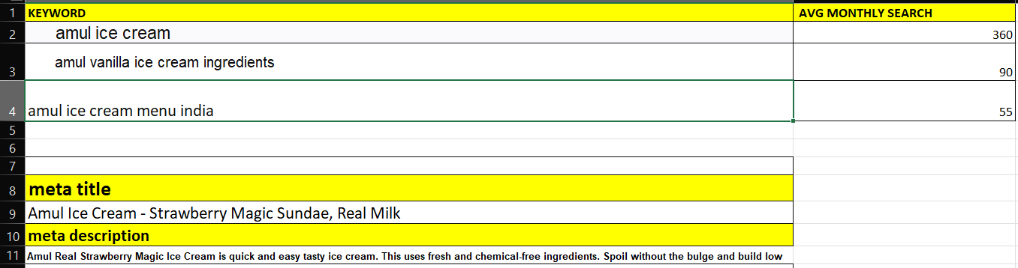
27

Slide 28
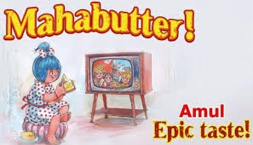
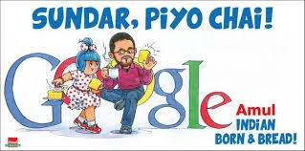
Content ideas and marketing strategies :
The Story of the Amul Girl, India’s Most Loved Ad Icon
The original brief was to create a mascot for Amul butter, positioned for children and mothers. The late Sylvester daCunha, along with illustrator Eustace Fernandes and Usha Katrak, among others, created the Butter Girl for Amul's campaign back in 1966
Amul’s Digital Marketing Strategy
Amul's digital marketing strategies have effectively utilized various online platforms to engage with their audience. Through social media channels like Facebook, Instagram, and Twitter, Amul has created a strong online presence and interacted with consumers in a personalized and engaging manner.
28

Slide 29
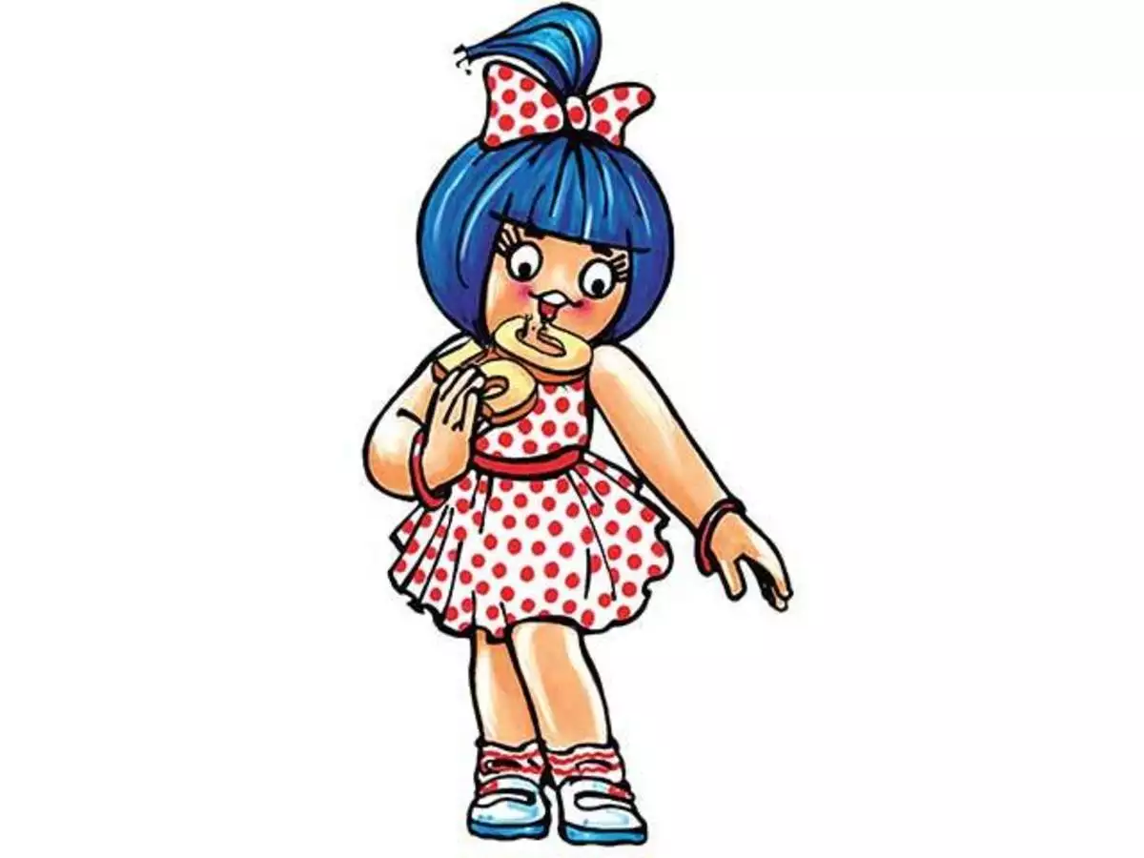
Top Marketing Campaigns of Amul
Amul Girl campaigns
The idea was conceived in 1967 once ASP (Advertising, Sales and Promotion) clinched the brand portfolio from the previous agency FCB Ulka. It was executed by Sylvester da Cunha, the owner of the agency, and his art director, Eustace Fernandes, on hoardings, painted bus panels, and posters in Mumbai..
Amul's Moment Marketing Plan
Moment marketing refers to using current events and trends to initiate relevant conversations with customers. It helps brands establish a common ground with their customers and relate to them. Moment-based marketing is often spontaneous, humorous, engaging, relatable, and relevant to current events.If done well, it can spark conversations around the brand and also help in word-of-mouth marketing. With the advent of social networks, it has become especially important for companies to create relatable content. Conversations in the comment box under a post determine how successful a marketing gimmick has been.The key to successful moment marketing campaigns is proactiveness. Moment marketing on certain events is only relevant in a short time window. If a brand does not act fast, the moment will pass, and the campaign will become redundant. Moment marketing doesn’t need to involve every event around you. Brands should engage with trends and events that sync with their idealogy.
29

Slide 30
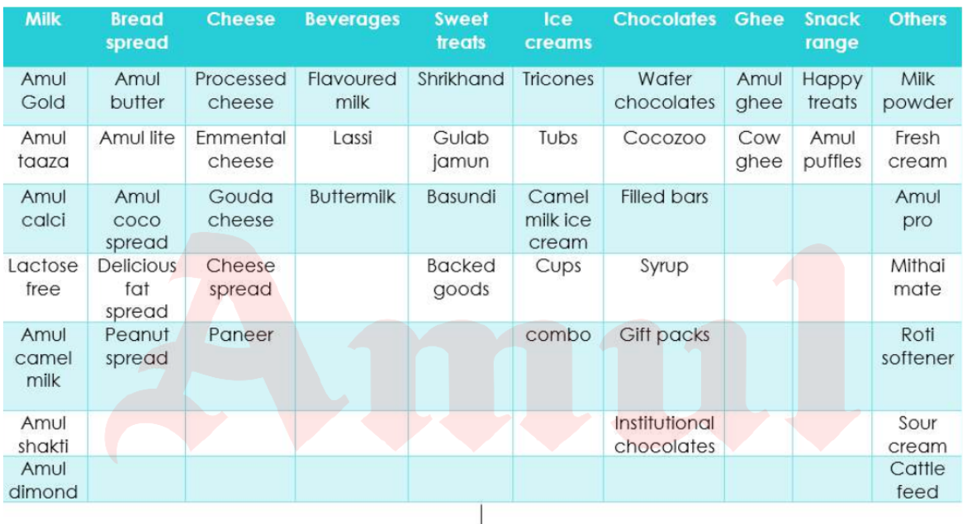
Amul products table
30

Slide 31
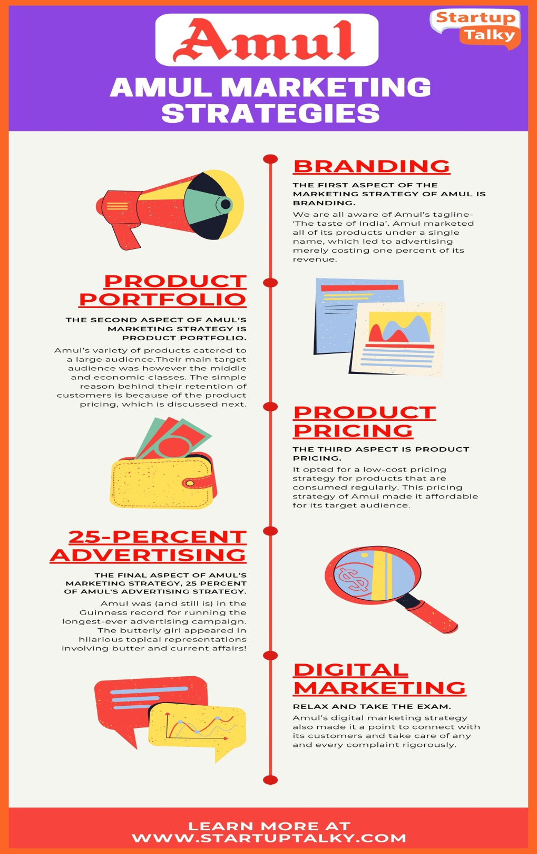
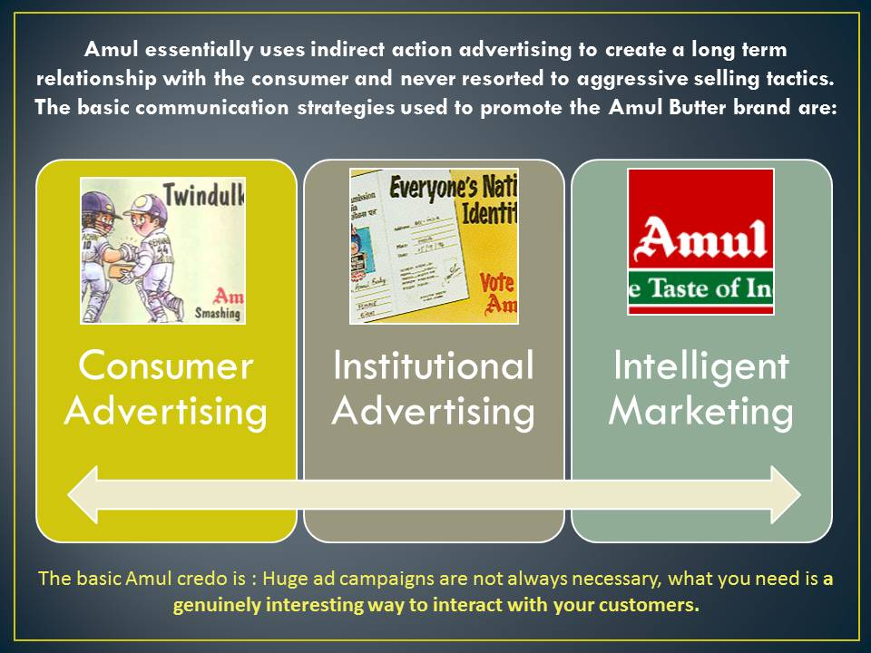
Amul marketing ideas and strategies chat :
31

Slide 32
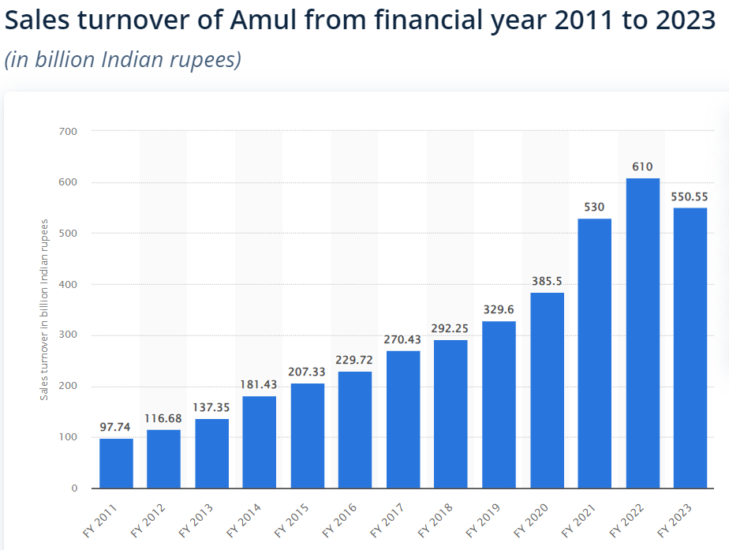
32

Slide 33
Format :1
Content creation and curation :
Recent updates of amul :
Amul hikes milk prices by Rs 2 per litre in Gujarat
Gujarat Co-operative Milk Marketing Federation (GCMMF) which markets dairy products under the brand name Amul has decided to increase milk prices with effect from Saturday (April 1) morning.
Amul hikes milk price by up to Rs 3/litre
Post this revision, the price of Amul Gold will be Rs 66 per litre , Amul Taaza will be Rs 54 per 1 litre, and Amul cow milk Rs 56 per litre and Amul A2 buffalo milk will now cost Rs 70 per litre, it said in a statement on Thursday.
Amul vs Nandini: Milk war hots up in Karnataka
Nandini is also keeping price points low at Rs 39 a litre for its packet milk, in a bid to protect its market, dairy industry sources said, even as Amul will retail its milk at higher price points in the capital of Karnataka.
Dairy brands Amul and Nandini will compete with each other in Bengaluru, one of the country’s largest milk markets, as the former makes an entry into the same.
Amul announced on Wednesday that it was entering the Bengaluru market, via e-commerce channels. The announcement created a social media storm, with hashtags such as #SaveNandini and #GobackAmul doing the rounds
Marketed by the Karnataka Milk Federation (KMF), Nandini is the largest supplier of milk in Bengaluru, at 23 lakh litres per day, which is about 70% of Bengaluru’s milk market, pegged at 33 lakh litres per day, according to dairy industry sources. Nandini is also keeping price points low at Rs 39 a litre for its packet milk, in a bid to protect its market, dairy industry sources said, even as Amul will retail its milk at higher price points in the capital of Karnataka.
33

Slide 34
Format :2
Debate between the milk brands Amul and Nandini
Amul is a well-known milk brand owned by the Gujarat Cooperative Milk Marketing Federation, whereas Nandini is a well-known milk brand owned by the Karnataka Milk Federation.
• Both are strong cooperative movements with thousands of dairy producers involved. The controversy was sparked by Amul's recent announcement that its goods will be sold in Bengaluru
.• In the lead-up to the elections, some have attempted to take advantage of the circumstance and instigate a discussion around the "outsider - sons of the soil" faultline.
• It's interesting to note that during the demonstrations and clashes, both GCMMF and KML sat as outsiders.
• Those demonstrating against Amul suggested that the company was attempting to supplant the Nandini brand.The discussion is distinctive since none of the cooperatives genuinely engaging in it are active combatants.
• In addition, there are two opposing viewpoints on the contemporary geopolitics of milk.
o Because we are a one nation, all goods, services, and brands must travel freely across it.
o Because a cooperative movement's culture is primarily local, outside intrusions must be prevented.
Is it all about politics?
The major players in the region, such as the Congress, JD(s) and BJP, stake their claims in the local elections and share assembly seats among them.
As with politics anywhere, they highlight milk cooperative issues to influence voters.
However, these are non-issues as per the local functionaries who say increasing procurement prices, waiving farm loans, and listing fodder prices should be in the focus.
34

Slide 35
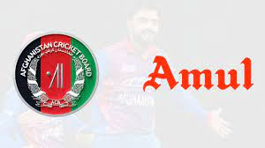
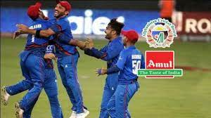
Format :3
Amul is official sponsor of the Afghanistan Cricket team for ICC World Cup :
Amul has been exporting dairy products to Afghanistan for 20 ..
Amul is the principal sponsor of the Afghanistan cricket team for the upcoming ICC Cricket World Cup hosted by England and Wales. Amul's logo will appear on the leading arm of Afghanistan team playing jerseys as well as on the training kits throughout the World Cup from May 30 to July 14, 2019. Commenting on the partnership, GCMMF Managing Director Dr. RS Sodhi said, "We are excited about being associated with Afghanistan Cricket for the first time and Amul is hopeful that this team, rated as the fastest growing team in International cricket, will deliver outstanding performance in the World Cup". He added, “Amul and Afghanistan share an old association. Khan Abdul Ghaffar Khan, popularly known as Frontier Gandhi had visited Amul in 1969 and had met Dr. V Kurien and studied the activities of our dairy cooperative.” Subsequently, several delegations of women milk producers from Afghanistan have visited Amul. Amul is a strong model of rural upliftment and women empowerment which has been recognised by the people of Afghanistan. Amul is also exporting its milk powders and baby food to Afghanistan since last 2 decades. Commenting on the association, Asadullah Khan, CEO of Afghanistan Cricket Board said "This is a big moment for Afghanistan cricket and we are extremely happy that Amul will sponsor us for the World Cup. This is the first time we will play in the World Cup as a full member and the preparations are good. We hope to do well". The ODI tournament sees Afghanistan team with a very good preparation heading to England with a number of key in form players fresh from IPL. The Afghanistan team will play a warm up match with Pakistan on 24th May and with England on 27th May.
35

Slide 36
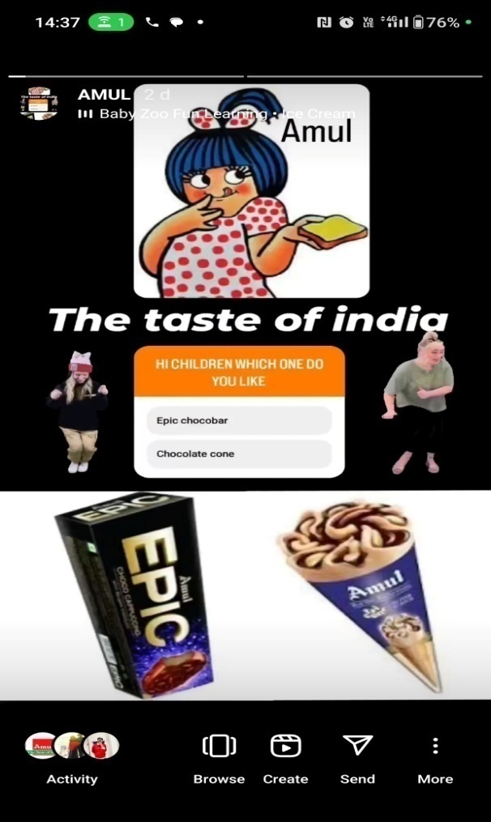
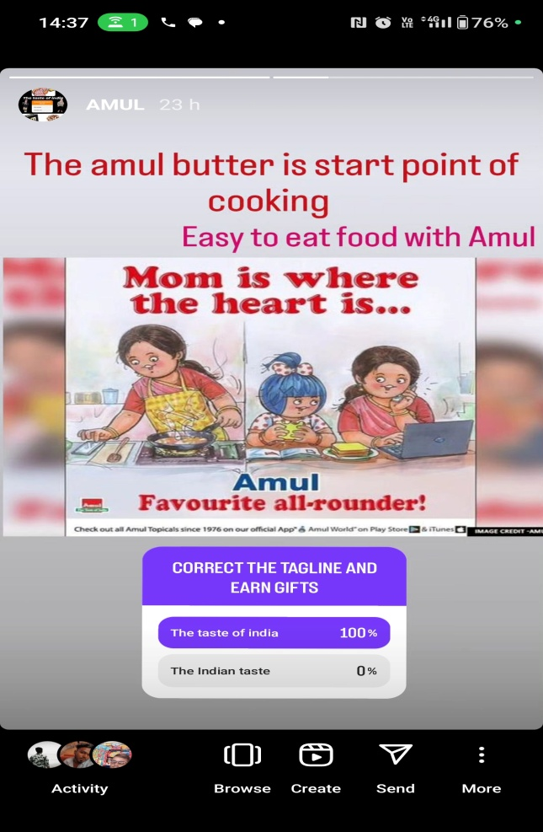
Instagram stories/highlights : :https://www.instagram.com/s/aGlnaGxpZ2h0OjE4MDI3MjkwMDg2NjM4NzIw?story_media_id=3213533984831418727_62405125644&igshid=NTc4MTIwNjQ2YQ==
https://www.instagram.com/s/aGlnaGxpZ2h0OjE4MDI3MjkwMDg2NjM4NzIw?story_media_id=3214051242532075324_62405125644&igshid=NTc4MTIwNjQ2YQ==
36

Slide 37
Conclusion :
Amul is a renowned Indian dairy cooperative that has made a significant impact on the country's dairy industry and has gained international recognition. The company's success can be attributed to several key factors.Firstly, Amul has a strong cooperative structure that involves millions of farmers as stakeholders. This cooperative model empowers farmers by ensuring fair prices for their milk and providing them with technical and managerial support. By involving farmers directly, Amul has created a sustainable and inclusive system that benefits the entire dairy ecosystem.Secondly, Amul has focused on product quality and innovation. The company has consistently maintained stringent quality standards, ensuring that its dairy products are safe, nutritious, and of high quality. Amul has also been proactive in adapting to changing consumer preferences and introducing new products, such as flavored milk, cheese, ice cream, and yogurt, to cater to diverse market segments.
37

Slide 38
THANK YOU
38

